Slide 1






LIQUID LEVEL DETECTOR

Slide 2
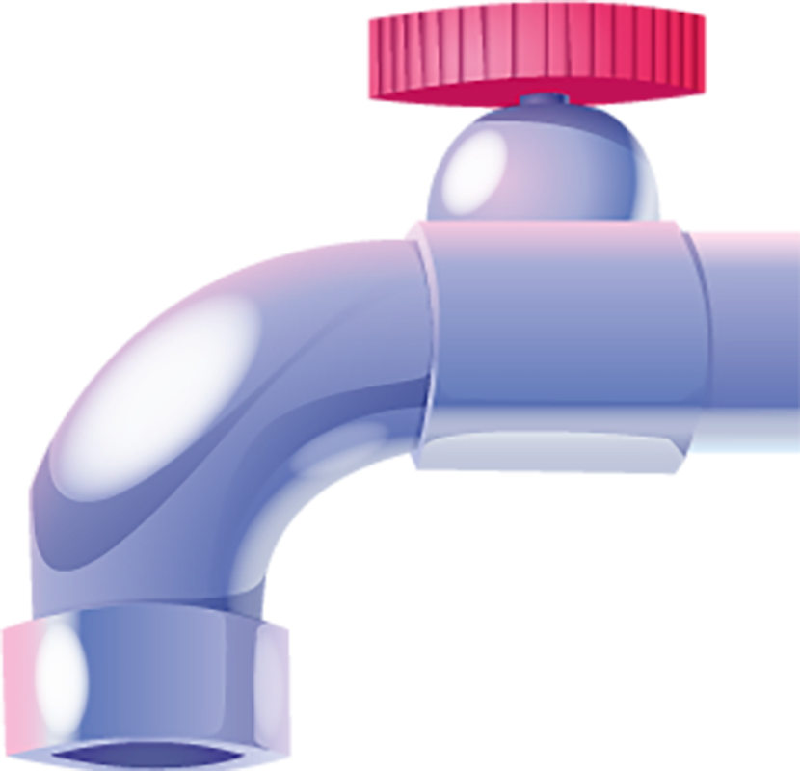



MEMBERS
M.M.M AMRY KAHDSE241F-023
DHANUSHANANDAN KAHDSE241F-028
M.A.M AMMAR KAHDSE241F-026

Slide 3



TABLE OF CONTENTS
01
INTRODUCTION
02
DEMONSTRATION
03
PROBLEMS OVERCOME
04
ADVICE FOR FUTURE RESEARCHERS
05
FUTURE IMPLEMENTATIONS

Slide 4


INTRODUCTION
A liquid level detector, used in water tanks, industrial processes, and fuel systems, monitors liquid levels in containers or tanks to prevent overflow or dry running of pumps.

Slide 5
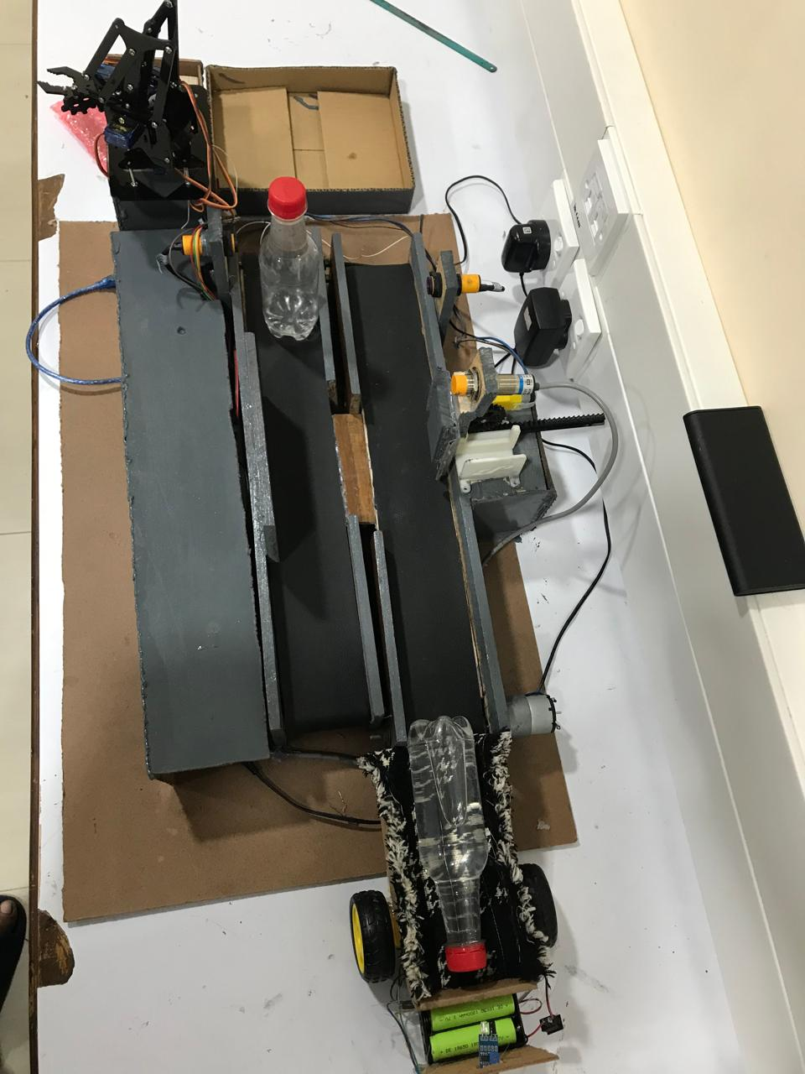

Slide 6
PROBLEM OVERCOME
Technical issues
Power Supply Issues

Slide 7
ADVICE FOR FUTURE RESEARCHERS
Researchers should focus on variety, accuracy, reliability, and practical solutions for liquid level detectors, incorporating advanced technologies, robust materials, wireless communication, and collaboration with industry experts.

Slide 8
FUTURE IMPLEMENTATIONS
Liquid level detectors are being changed by technological breakthroughs that enable real-time monitoring and predictive maintenance. These innovations include IOT integration, AI-driven analytics, and improved sensors, which increase efficiency and variety.

Slide 9


THANK YOU !

